Slide 1

Real Estate
Market
in King County
Data-driven insights and predictive modelling

Slide 2
Business Understanding
Goal - create a platform that delivers accurate estimates of house prices
Develop a model that can identify the key factors influencing house prices.
Requirements - precise and representative data related to the real estate market in king county,
Notes:
-Primary goal is to create a platform that delivers accurate estimates of house prices which are crucial for both buyers and sellers in King county.
-To achieve this objective we need to develop a model that can identify the key factors influencing house prices.
-To effectively train this model the client requires precise and representative data related to the real estate market in king county, including historical sales, current listings, property size, and other relevant features.
-. The expectation is that, once completed, the model can be used by them as a tool in selecting properties for investment in King County.

Slide 3
Problem Statement
Advertising Campaign to encourage sales in King County
● Data-driven recommendations
● Model to predict house prices

Slide 4
Analysis
Qn 1: What features are most closely connected with changes in house prices?
Qn 2: Which features show the strongest connections with other factors that help predict house prices?
Qn 3: What combination of features gives the most accurate predictions for how much a house will cost?

Slide 5
Methodology
● Gather relevant data and perform comprehensive analysis to understand its structure, quality, and potential insights
● Delve into the features of the dataset to uncover meaningful patterns and insights that can inform the prediction model.
● Construct a prediction model using appropriate methodologies, incorporating the insights gained from data analysis and feature investigation.

Slide 6
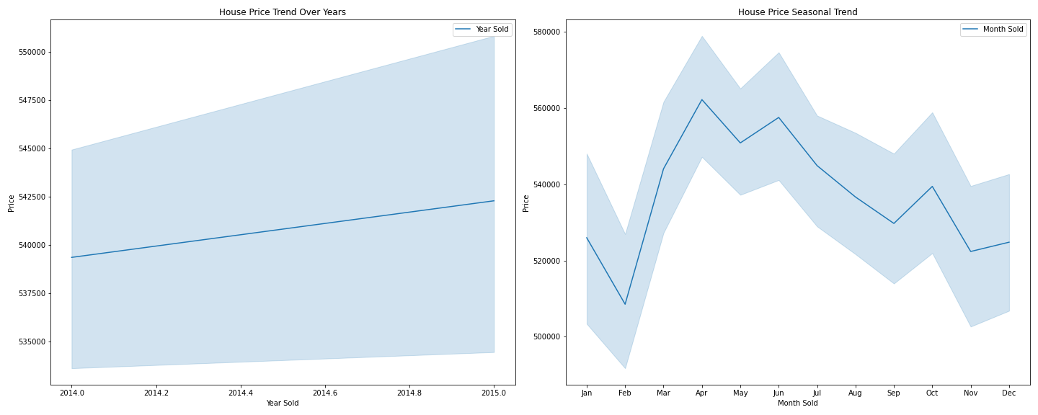
House price trends

Slide 7
In the graphs below;
We analyzed the variation of average house prices as per the overall condition of a house, whether a house is located on a waterfront or not, the quality of views from the house and the number of floors/ levels in a house.

Slide 8
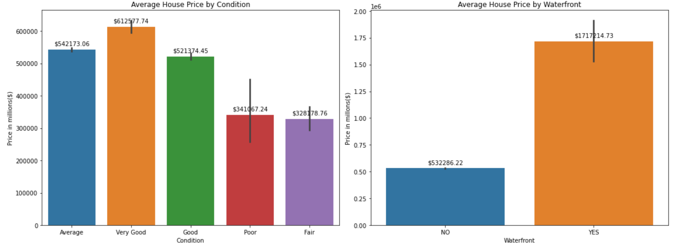

Slide 9
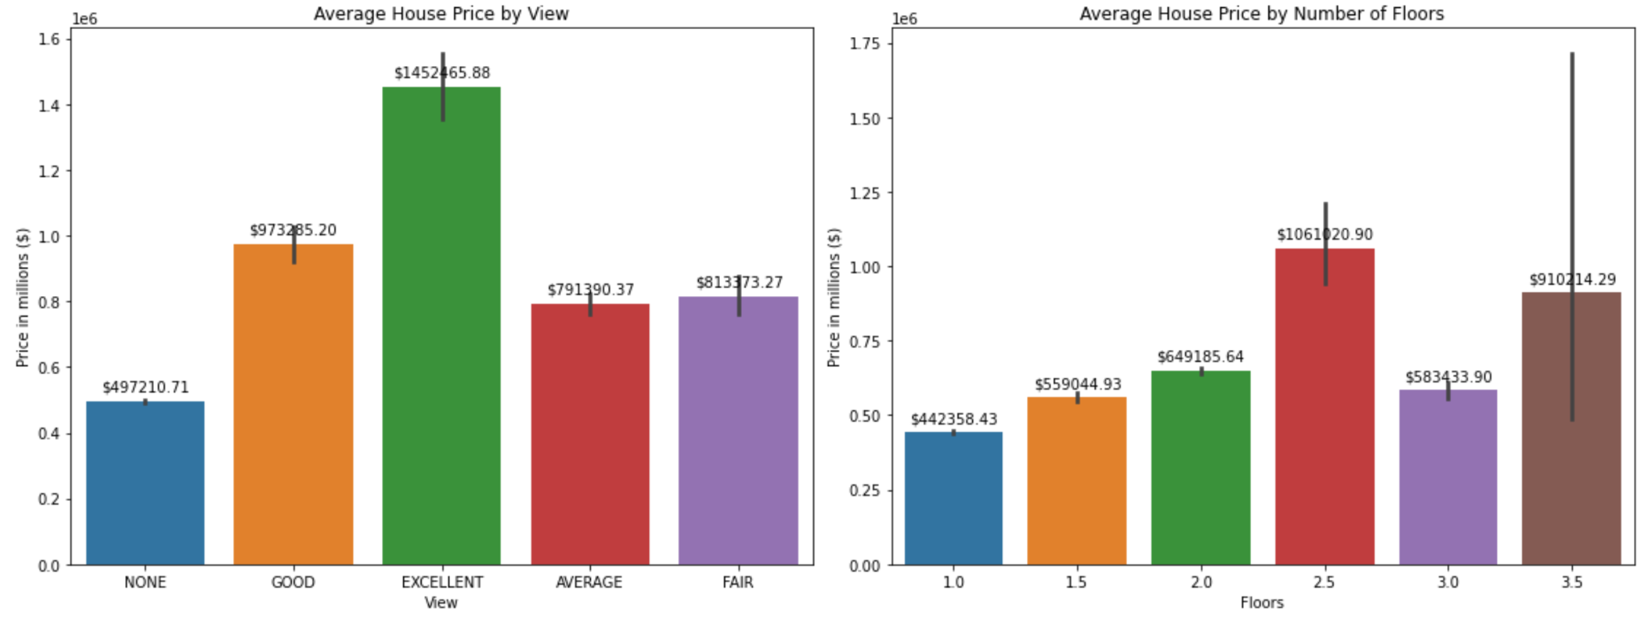

Slide 10
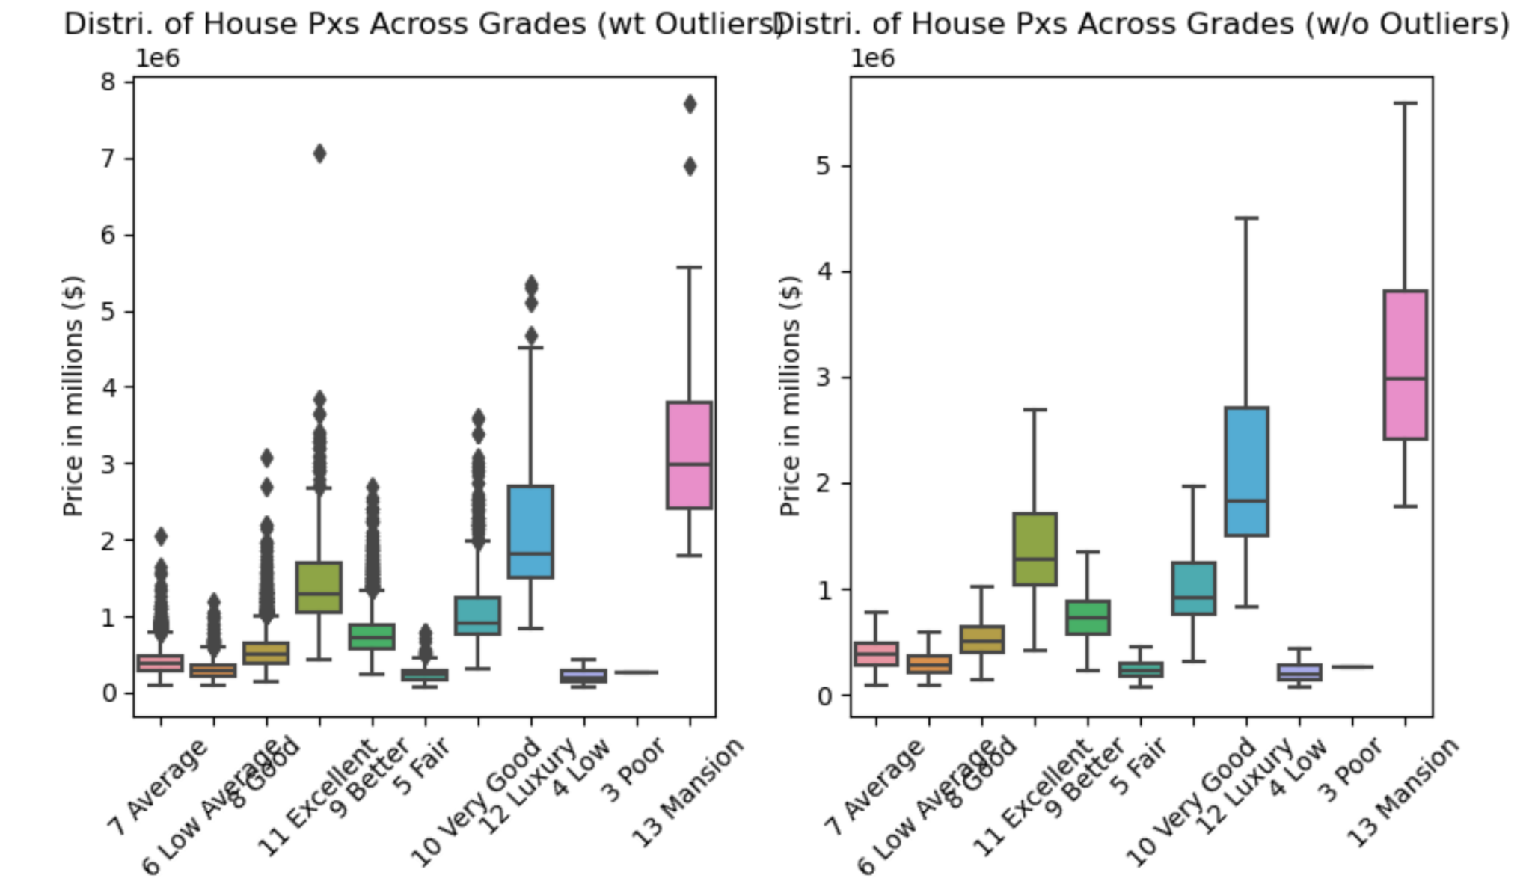
Assessing the change in house price values as per the grade, condition and waterfront location of a house with and without outliers using box plots as shown below.

Slide 11
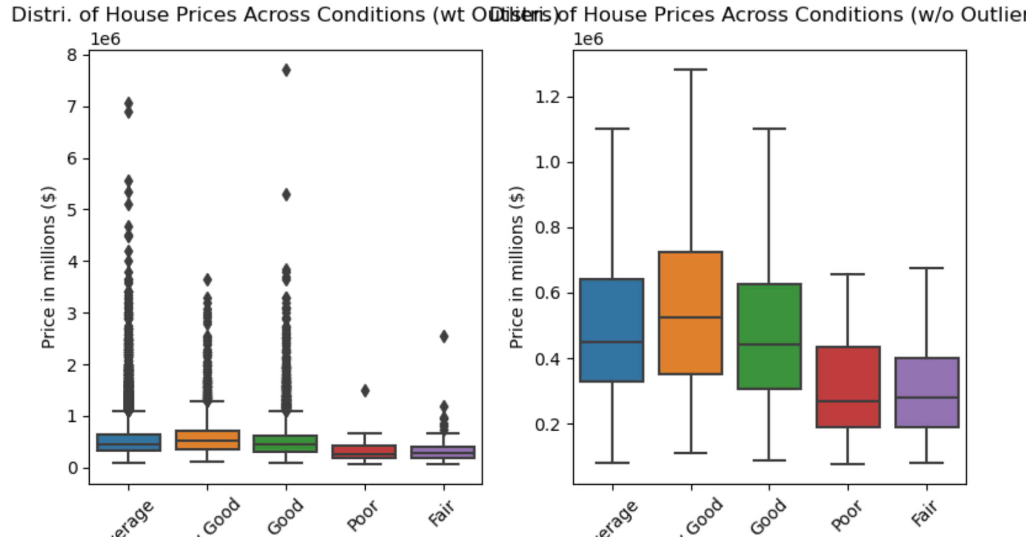

Slide 12
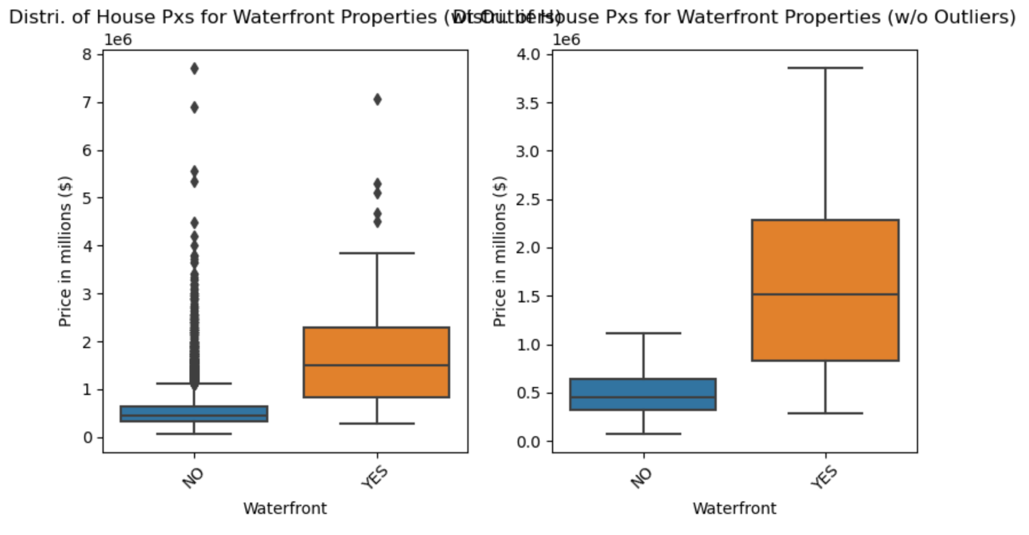

Slide 13
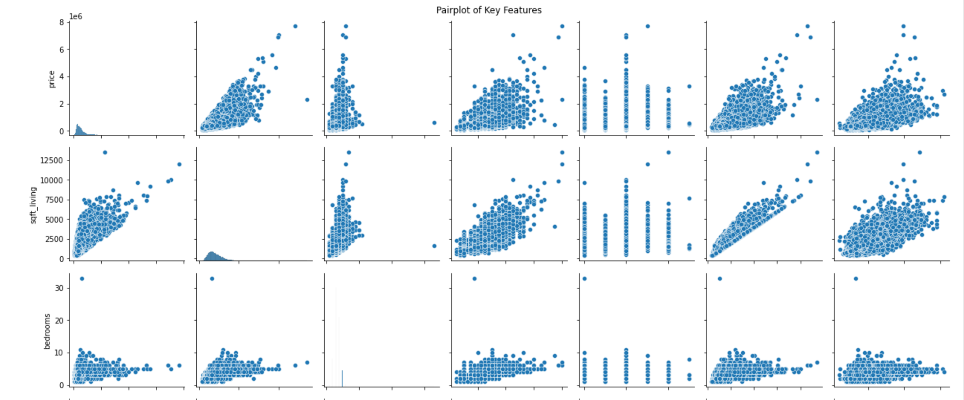
Scatterplots to visualise and explore the relationships between multiple variables

Slide 14
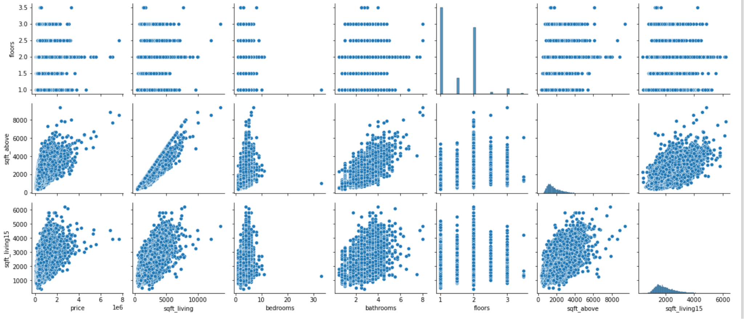

Slide 15
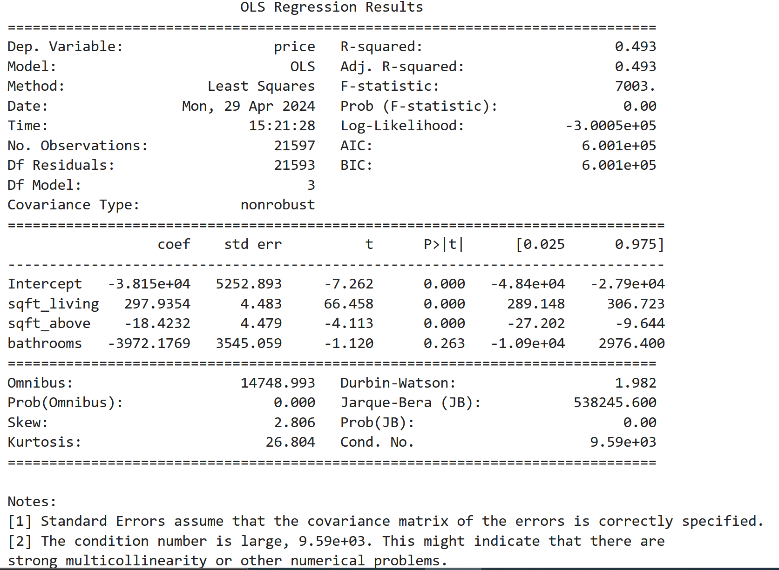
General overview on the variables that have a strong correlation with the price

Slide 16
Simple linear regression:
Linear regression model with price as the dependent variable and sqft_living as the independent variable to determine the coefficient and y-intercept

Slide 17
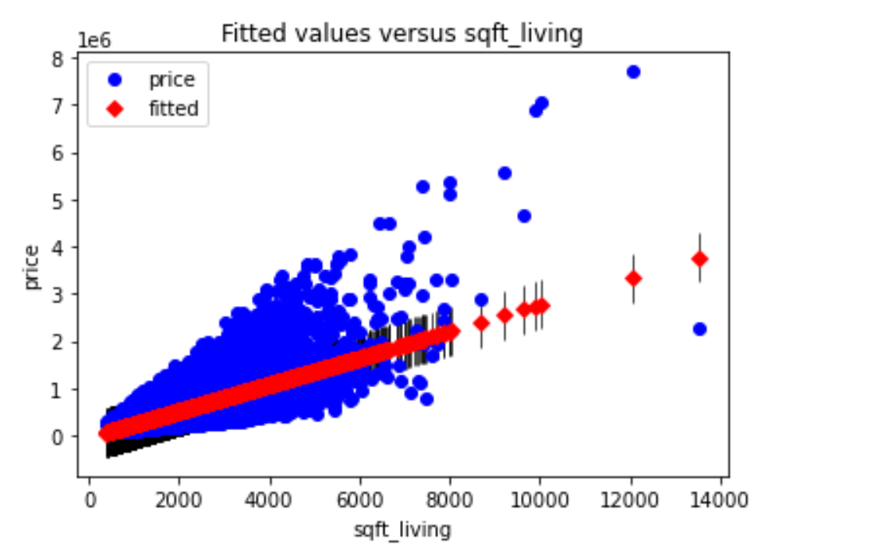
Plotting actual and predicted values

Slide 18
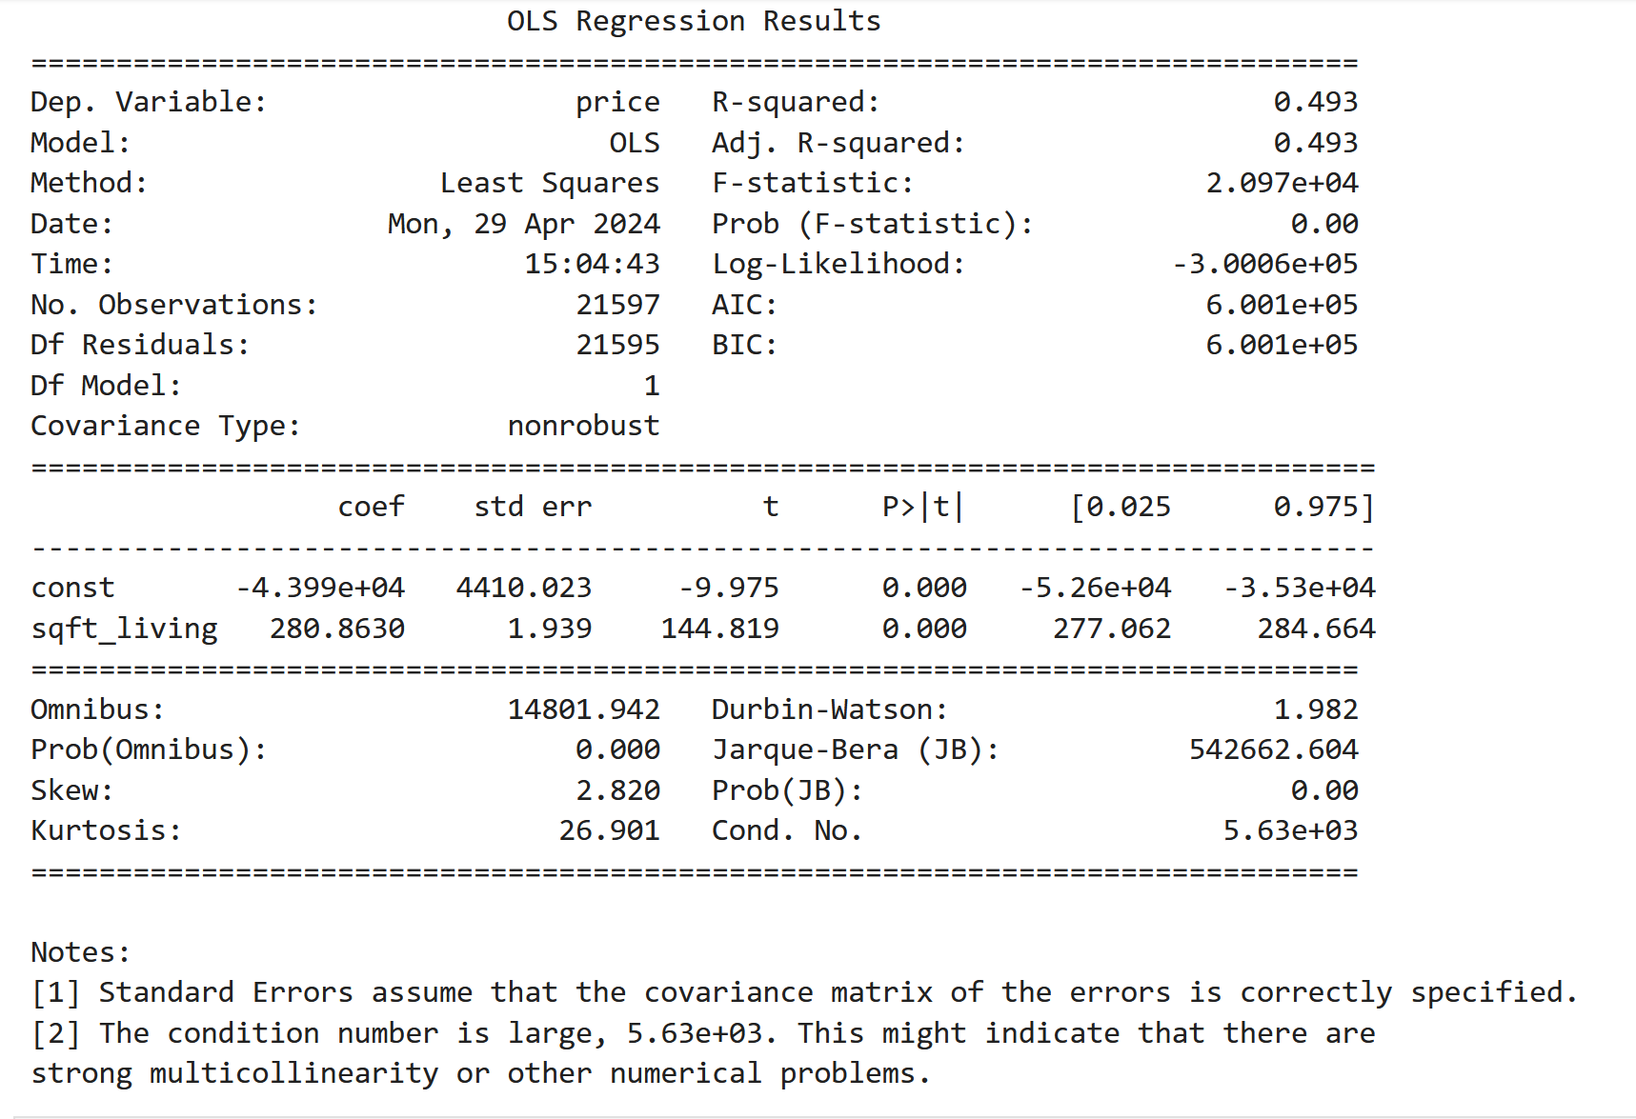

Slide 19
Multiple linear regression:
Incorporating all other features we were interested in to understand their impact on price based on the baseline model.

Slide 20
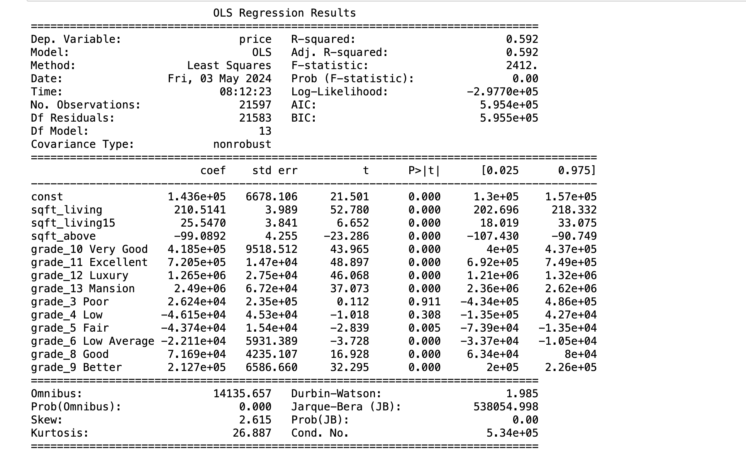
Results

Slide 21
Train – test results
After Training our data using the (80/20, 70/30, 60/40 ) ratios, we noticed that the model with the 80/20 had the highest r squared. This conclusion can be inferred since they were all scaled uniformly and they used the same predictor variables all through.
`Random Forest Regression` of the 80/20 split is the most accurate with `59.31`% of house price variance explained with a Mean Absolute Error of `155053.45818852124` dollars.

Slide 22
Key takeaways
Positive Influencers on Price:
The presence of additional bathrooms increased square footage, higher floors, waterfront access, captivating views, and elevated grade scores positively impact house prices.
Notably, the inclusion of cities like Medina and Mercer Island in the analysis reveals their positive association with higher property values.
Negative Influencers on Price:
The number of bedrooms, certain city affiliations (e.g., Auburn, Federal Way, Kent), in reference to Bellevue, and specific features (e.g., Fall Season, City) exhibit a negative correlation with house prices.
Premiere Property Group should be cognizant of these factors when devising pricing strategies.
Seasonal and Unique Factors:
While some seasonal variables do not significantly impact prices, it's crucial to note that the age of the house and the presence of a basement can influence pricing dynamics.
City-Specific Considerations:
Each city has a unique influence on house prices, emphasizing the need for tailored strategies for different locations

Slide 23
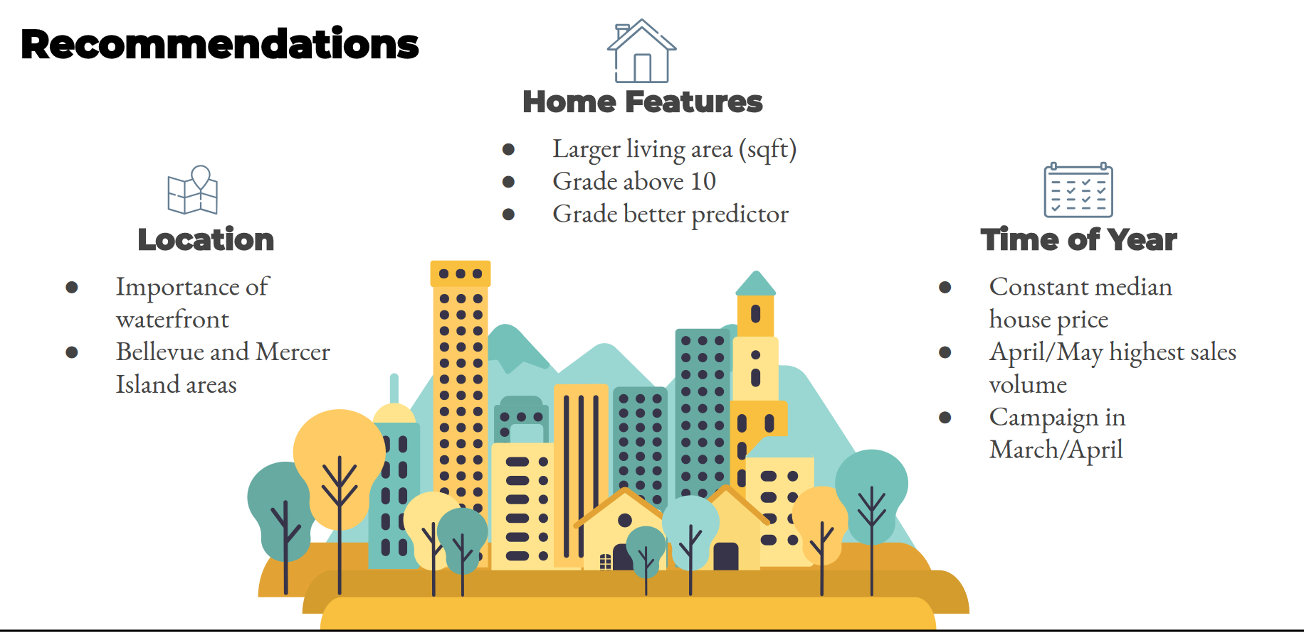

Slide 24
Recommendations
Market Positioning Strategies: Sellers should leverage insights into key price-driving factors to strategically position their properties in the market. Emphasize features eg. spacious living areas, recent renovations, and waterfront access to increase property attractiveness and market competitiveness.
Investment Considerations: Investors should carefully evaluate properties based on their potential for value appreciation. Prioritizing investments in neighborhoods with proximity to amenities and waterfront locations could yield higher returns.
Buyer Awareness: Should be cognizant of the factors influencing house prices when making purchasing decisions.

Slide 25
Insights
Key Factors Affecting House Prices: Square footage of living space emerges as the primary driver of house prices. Features like grade, waterfront status and recent renovations correlate with prices, underscoring their impact on property values.
Significance of Property Characteristics: The number of bedrooms and bathrooms also contribute to determining house prices, albeit with varying degrees of influence.
Neighborhood and Environmental Factors: Proximity to amenities positively correlates with house prices implying that location remains a critical factor in property valuation.
Modeling and Predictive Insights: Employing regression models such as Simple Linear Regression and Multiple Linear Regression coupled with iterative modeling and feature engineering techniques, enhances the predictive accuracy of models.

Slide 26
Conclusions
The dataset's geographic and temporal constraints may restrict the generalizability of findings to other regions or time periods.
The analysis equips stakeholders, including homeowners, real estate professionals, and potential buyers with actionable insights to navigate the housing market effectively.
Leveraging knowledge of key price determinants and understanding the nuances of property valuation, stakeholders can make informed decisions regarding pricing strategies, property investments and market participation.
Continued research and analysis are warranted to refine models and explore additional factors for enhanced predictive accuracy and comprehensive market understanding.

Slide 27
OPPORTUNITIES FOR FURTHER ANALYSIS
Micro-location Trends
Analyzing long-term Market Trends
Economic and Demographic Factors
Advanced Predictive Modeling
Impact of Renovations
Customer Segmentation and Targeting

Slide 28
THANK YOU!

